Slide 1
Details on mass meassurements

Slide 2
A mass-spec has 4 tasks…
Create ions from analyte molecules
Separate the ions based on charge and mass
Select and fragment ions of interest to provide structural information (MS/MS)
Detect ions and determine their mass-to-charge (m/z)

Slide 3
…and 5 parts
Sample inlet
Ionization
Mass analyser
Detector
Data acquisition
High or ultrahigh vacuum

Slide 4
Sample inlet
Ionization
Mass analyser
Detector
Data acquisition
High or ultrahigh vacuum

Slide 5
The basics of mass meassurements
Resolution
Mass accuracy
Isotopic distribution

Slide 6
Resolution and mass accuracy
Resolution: The ability to discriminate molecules of similar mass
Mass accuracy: the ability to accurately measure the mass of a molecule

Slide 7
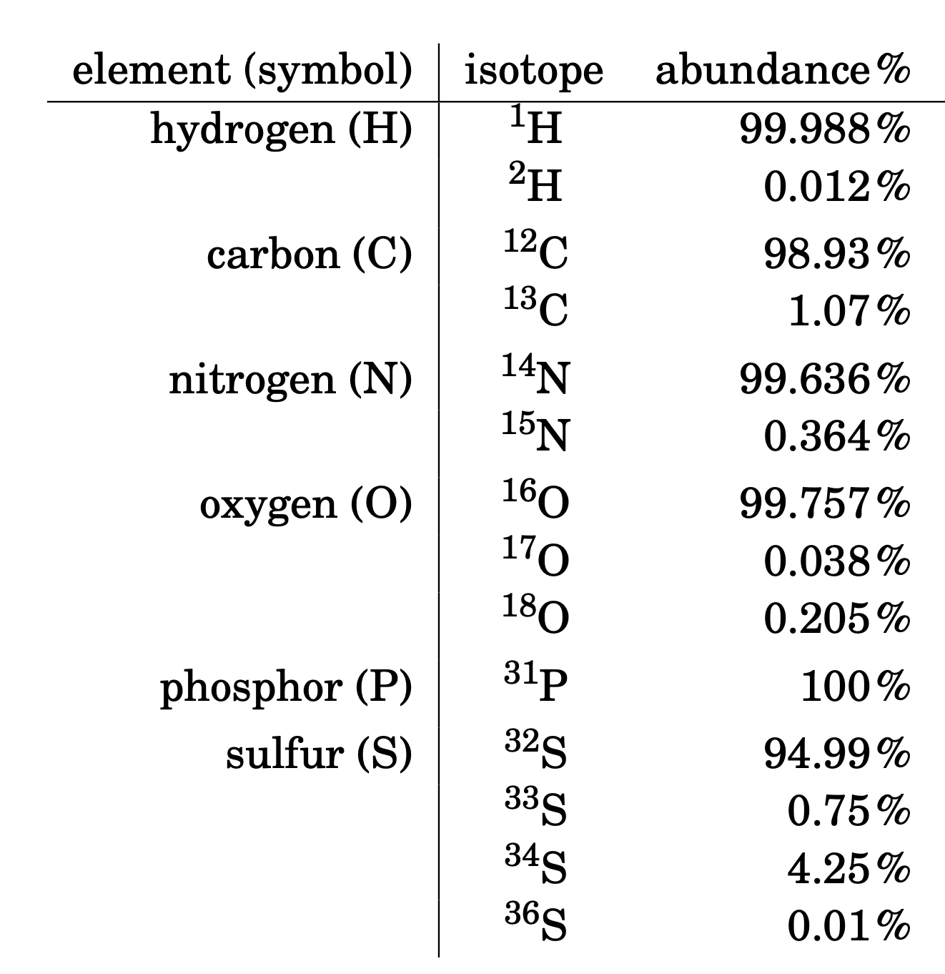
Natural isotopic distribution: relative abundance of isotopes
Most elements occur in nature as a mixture of isotopes
Isotopes are atom species of the same chemical element that have different masses
They have the same number of protons and electrons, but a different number of neutrons (1Da)
The main elements occurring in proteins are CHNOPS

Slide 8
Low vs high resolution
Average mass: equivalent to taking the centroid of the complete isotopic envelope
Monoisotopic mass: the mass of the first peak of the isotope distribution.
GluFib: EGVNDNEEGFFSAR
MW: 1569.6696 Da
Chemical Formula:
C₆₆H₉₅N₁₉O₂₆

Slide 9
Mass meassurements
Average mass: equivalent to taking the centroid of the complete isotopic envelope
Monoisotopic mass: the mass of the first peak of the isotope distribution.
A
Monoisotopic mass
(most abundants elements: ¹²C, ¹H, ¹⁴N, ¹⁶O)
A+1
Signals related to lower abundance isotopes
A+2
GluFib: EGVNDNEEGFFSAR
MW: 1569.6696 Da
Chemical Formula:
C₆₆H₉₅N₁₉O₂₆
A+3
A+4

Slide 10
The distances between isotopic peaks reveal charge state
M = 1000 Da (not charged)
M = 1000 Da
[M+2H]²⁺ z = 2
m/z = 501 Da
M = 1000 Da
[M+3H]³⁺ z = 3
m/z = 334.33 Da
[M+1H]¹⁺ z = 1
m/z = 1001 Da (Monoiso.)
Isotopic distribution
1001
501
334.33
1002
501.5
334.66
1003
502
335
m/z
m/z
m/z
1 Da
0.5Da
0.33Da

Slide 11
The resolution drives mass accuracy and allows charge deconvolution
Charge state
Resolution
Mass accuracy

Slide 12
Extra material

Slide 13
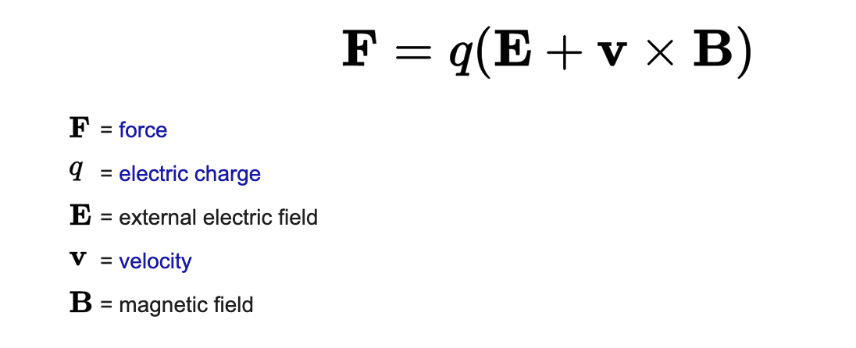
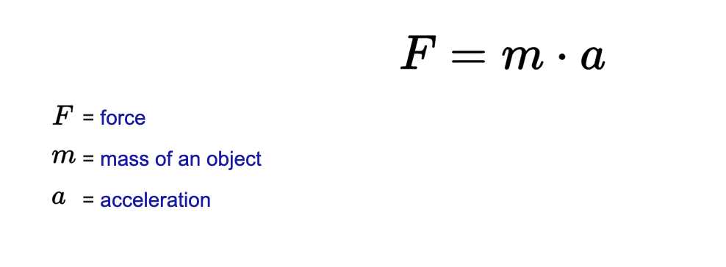
The effect of electromagnetic fields on ions
The force applied to an ion in a field is governed by 2 laws:
Lorentz force law and Newton’s second law

Slide 14
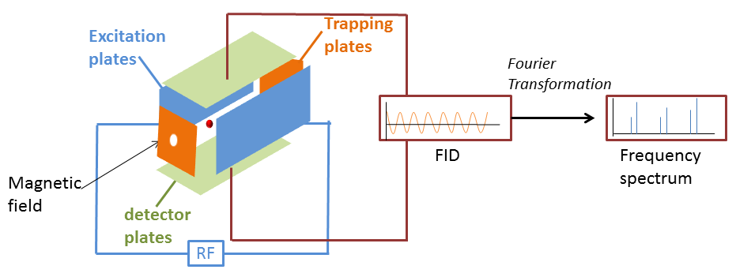
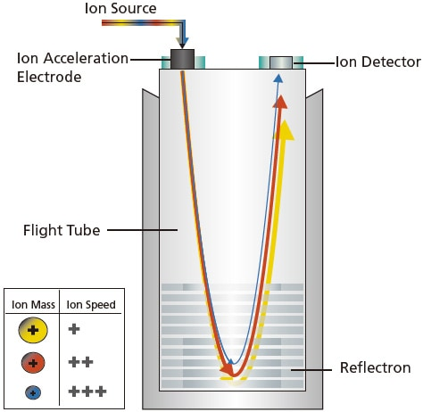
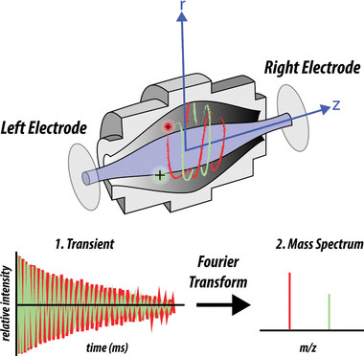
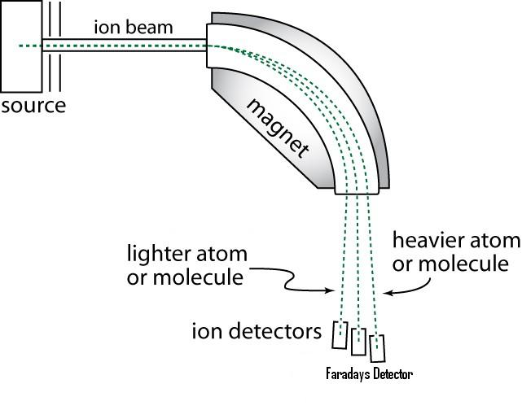
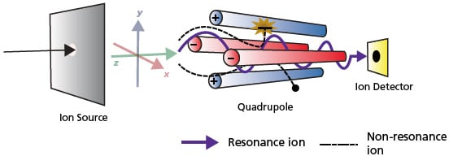
Mass analysers
Separate ions based on mass-to-charge (m/z) ratio
6 main types
Different analyser ☞different principle ☞ different characteristics ☞ different application
Field-free
Electric Field
Magnetic Field
Ion Traps (IT)
Ion cyclotron resonance (ICR)
Time-of-Flight (TOF)
Magnetic sector
Orbitrap
Quadrupole

Slide 15
Quadrupole Theory
$$a_{x}=−a_{y}= \frac{4qU}{m_{i}{r_{0}}^{2}ω^{2}}$$
$$q_{x}=−q_{y}= \frac{2qV}{m_{i}{r_{0}}^{2}ω^{2}}$$
4 parallel metal rods of opposite polarity
RF voltage applied between one pair of rods and the other
Direct Current (DC) voltage superimposed on the RF voltage
Ions can travel between the rods at given RF and DC voltages
DC
Component
RF
Component
Unstable
Region
Stable
Region
Resolving DC (a-value)
  RF amplitude (q-value)
$U$: DC voltage
$V$: RF amplitude
$q$: ion charge
$m_{i}$: ion mass
$r_{0}$: quadrupole radius
$ω$: RF frequency

Slide 16
Isolation Using Quadrupoles
By varying the DC voltages and RF amplitudes, it is possible to select ions with different m/z values and to vary isolation width.
Set DC voltage
Set RF amplitude
Full spectrum
With Quadrupole Filtering
Resolving DC (a-value)
  RF amplitude (q-value)
m/z
m/z
m/z

Slide 17
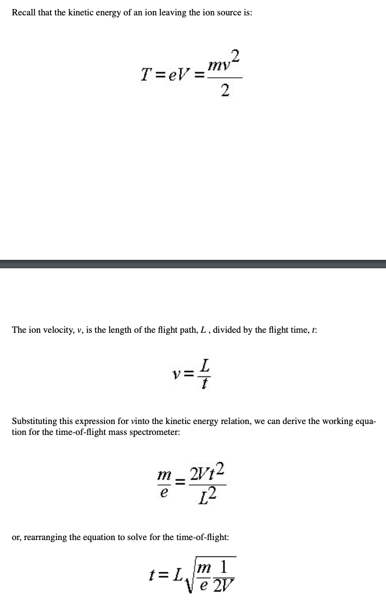
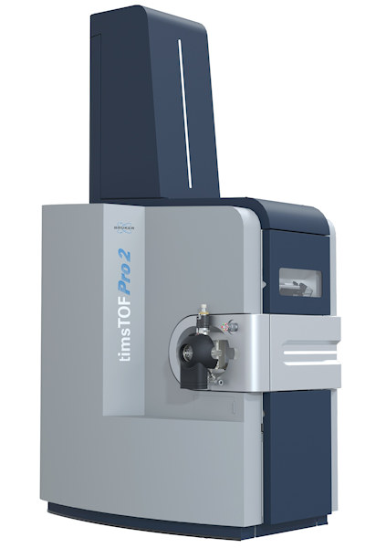
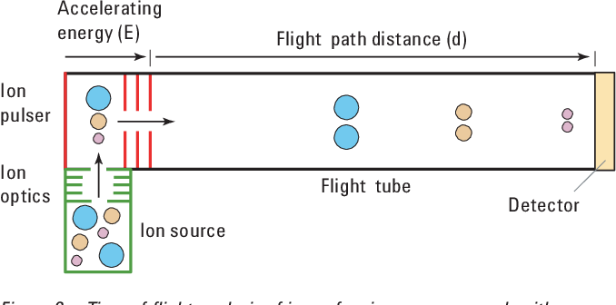
TOF
Consists of an acceleration region with a homogeneous electric field and a field-free drift region
Different m/z -> different velocities -> different time to reach the detector
Requires a pulsed ion source (ex. MALDI) or pulsing ion packages out of a continuous beam (pulser for ESI)
https://doi.org/10.1002/mas.21520

Slide 18
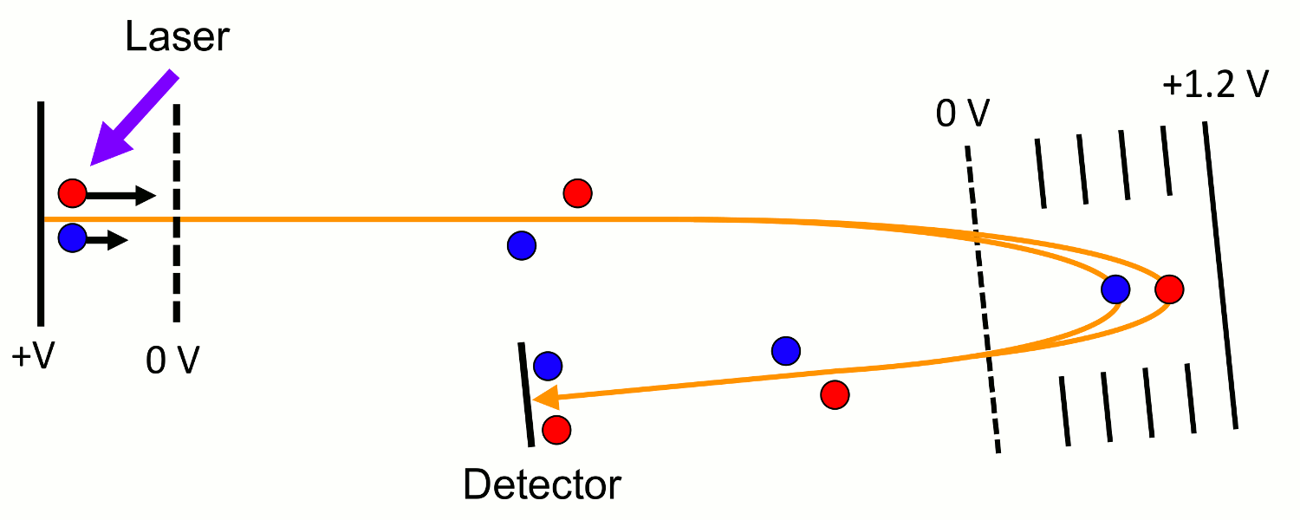
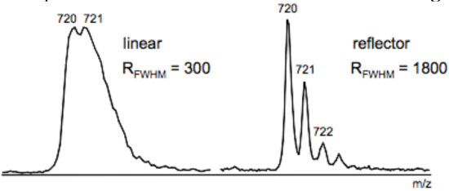
TOF: reflector
Reasons for poor resolution
Different starting times
Different initial kinetic energies
Different starting locations
Different initial directions of motion

Slide 19
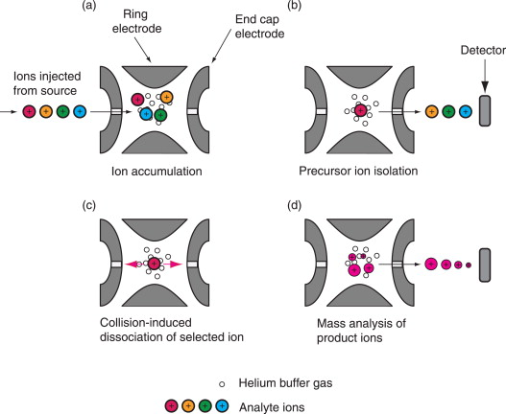
Ion Traps (IT)
3D and 2D
Operate on the same plysical principles as quadrupoles
Filled with He
Trap
Isolate
Fragment (Collision Induced Dissociation, CID)
Quadrupole IT (aka 3D): Ions trapped in 3 dimensions, space charging effect
Advantages of Linear IT (aka 2D)
50x ion storage capacity
20x higher injection efficiency
simplicity of construction
http://dx.doi.org/10.1016/j.cplett.2016.11.011

Slide 20
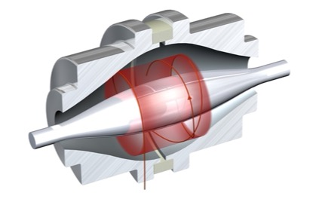
Orbitrap
Electrostatic field applied between 1 central spindle electrode and 2 halves of outer shell electrode
A short ion packet of one m/z enters the field tangentially, off-equator
Ions are squeezed towards the central electrode by increasing voltage on the central electrode
In the axial direction, ions are forced to move away from the narrow gap towards the wider gap near the equator
This initiates axial oscillations without the need for any further excitation
(“excitation by injection”)
After the voltage increase stops, ion trajectories become a stable spiral
r
z
φ
https://doi.org/10.1021/ac4001223

Slide 21
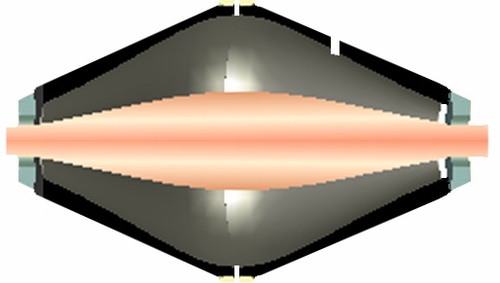
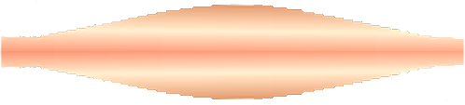
Individual Ion Transients
Amplitude
Time
z
Data
Reduction
Fourier Transform
Amplitude
Time
Intensity
Raw Transient
The two outer electrodes are used to detect the image current produced by ions oscillating along the z-axis.
Many ions in the Orbitrap generate a complex signal whose individual frequencies are determined using a Fourier Transformation
Frequency →
Intensity
m/z

Slide 22
Characteristics of different mass analyzers
Mass
Analyzer
Mass
Accuracy
Resolution
(FWHM)
Scan
Rate
m/z
Range
Cost
TOF
Very good
5 ppm
High
20,000
Very fast
μs
Very wide
$$
Ion trap
Good
100 ppm
Low
Unit mass
Fast
ms
100 – 4000
$
Quadrupole
Good
100 ppm
Low
Unit mass
Normal
s
100 – 4000
$
Orbitrap
Excellent
< 2 ppm
Very high
>100,000
Normal
s
100 - 4000
$$$

Slide 23




Disclaimer: No size fits all
Cost
Application
Question
Priorities

